Slide 1

DS PROJECT
Grp-35

Slide 2
ANDHRA PRADHESH HEALTH CARE INSURANCE
Aarogyasri Scheme is a unique Community Health Insurance Scheme implemented in Andhra Pradesh in 2007 which provides financial protection up to Rs. 2 lakhs per year to families living below poverty line for the treatment of serious ailments requiring hospitalization and surgery. This scheme provides financial protection to the families below poverty line by providing coverage for critical systems like Heart, Lung, Liver, Pancreas, etc.

Slide 3
Key words:-
Preauth amount :- Preauthorization amount is the initial Amount authorized to the insurer along with admitting to paying the claim subject to the final invoice from the hospital.
Preauth date :- The date when preauth amount is authorized
Claim amount :- Amount of money which is to be paid at the maturity of an insurance policy or in event of the death of the insured person
Claim date :- the date when claim amount is issued
Mortality:- death of the insurer

Slide 6

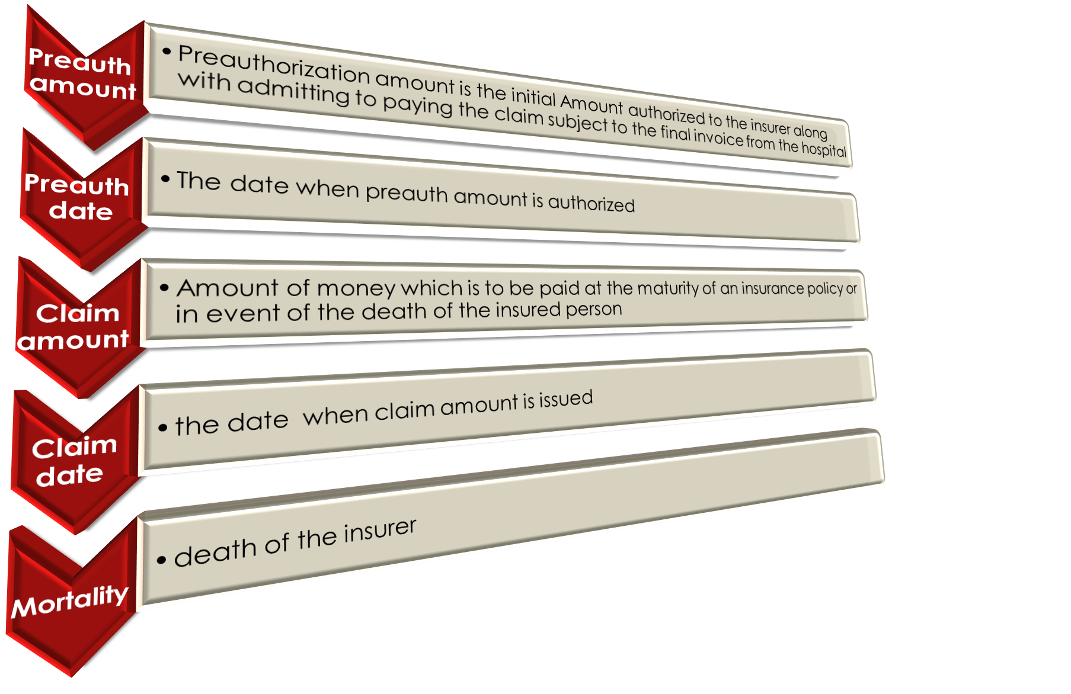

Slide 7
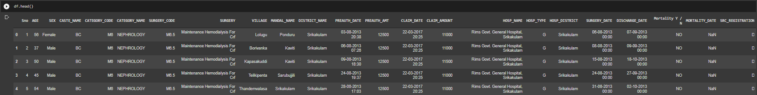
Pre processing and Cleaning:-

Slide 8
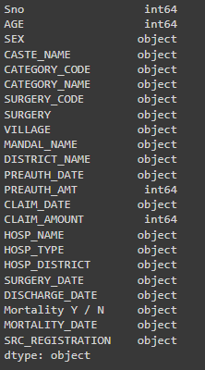
Columns in the Data set:-

Slide 9
DATA VISUALIZATION
Data visualization is the practice of translating information into a visual context, such as a map or graph, to make data easier for the human brain to understand and pull insights from.
The Data of this project can be described in various forms of graphs and plots discussed further.

Slide 10
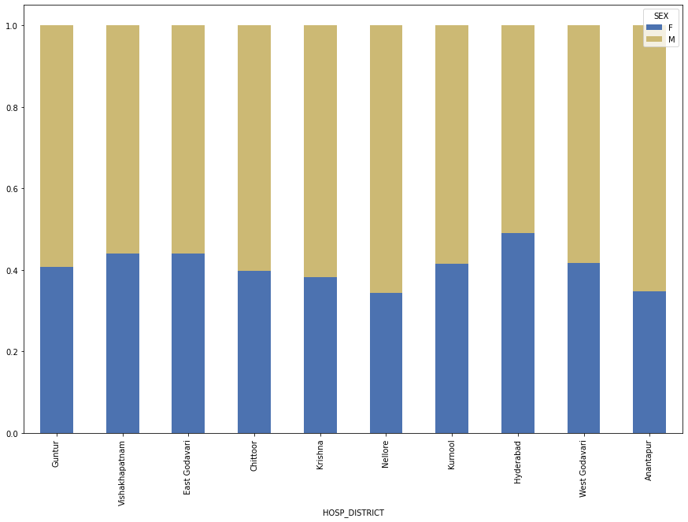
Sex ratio of Insurers in different District

Slide 11
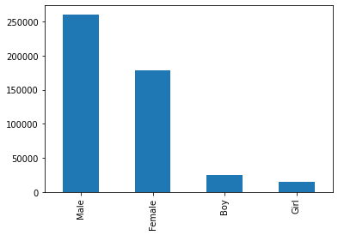
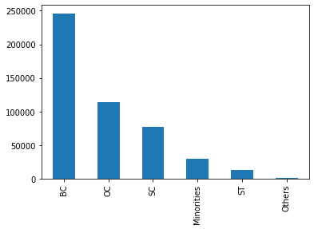
Distribution of people according to caste
Distribution of people according to sex

Slide 12
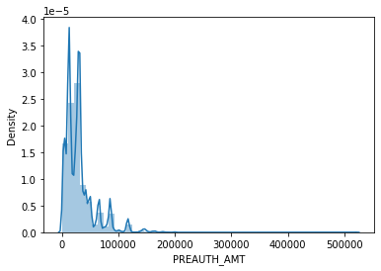
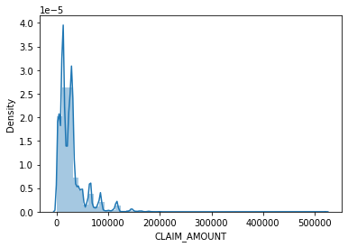
Pre-authorization amount Distribution
Claim amount Distribution

Slide 13
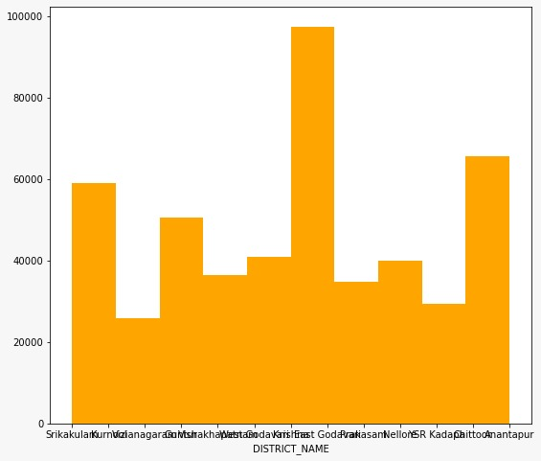
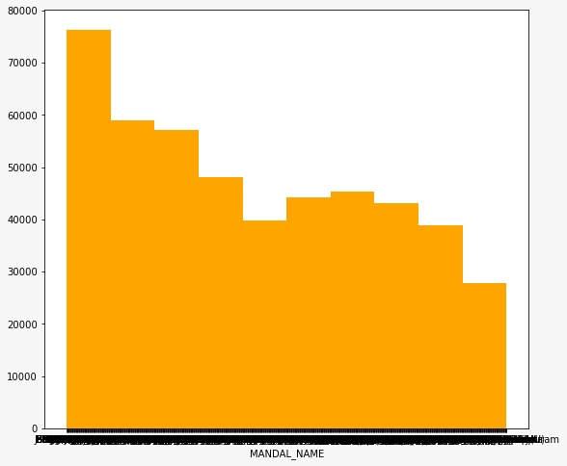
Distribution according to Mandal
Distribution according to District

Slide 14
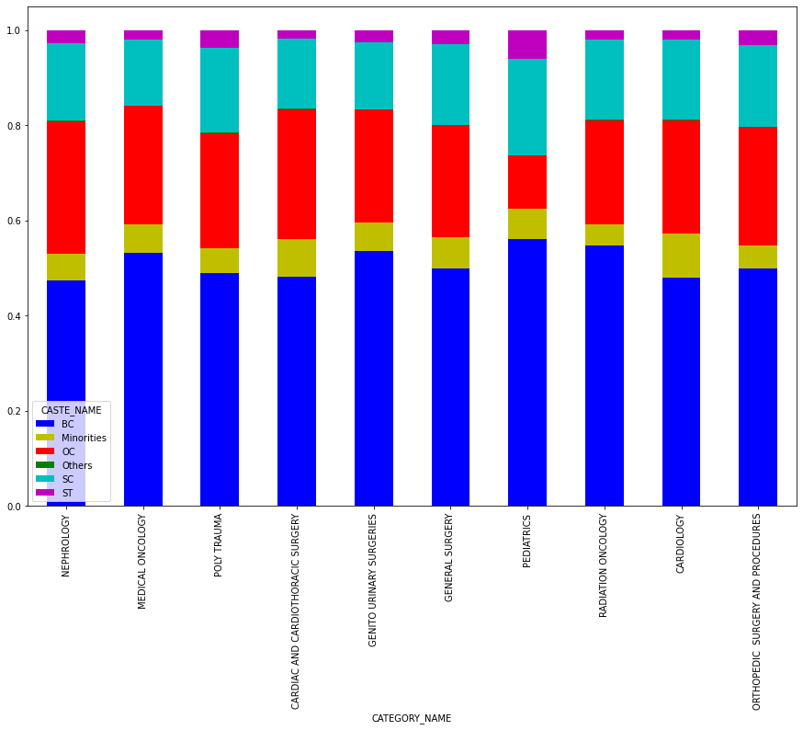
Distribution of people according to Category and caste(as per the ratio)

Slide 15
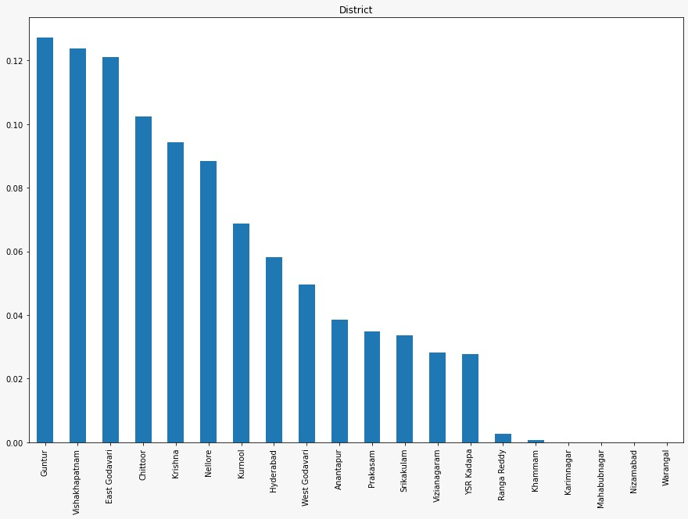
Distrubution of Population with
Respect to Districts

Slide 16
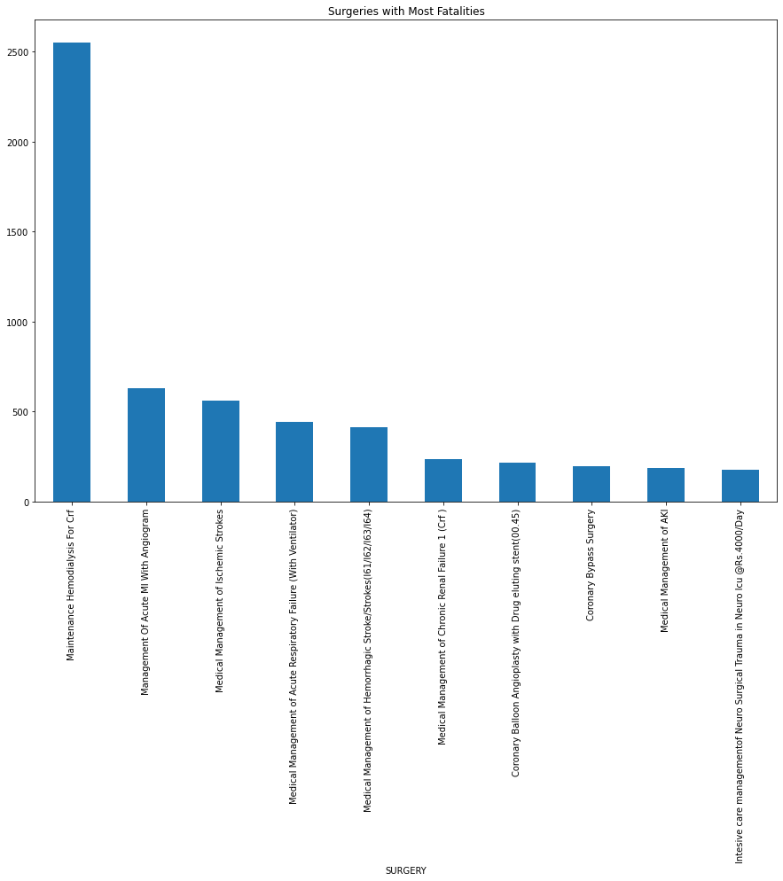
Surgeries with most fatalities

Slide 17
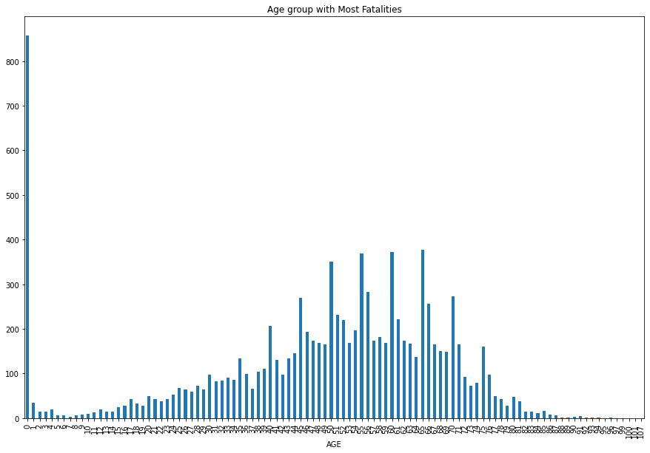
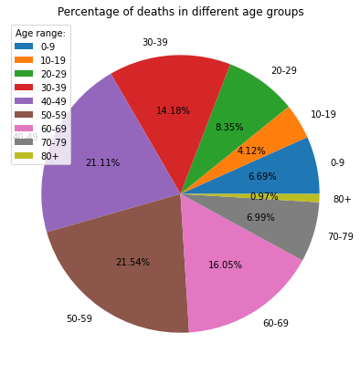

Slide 18
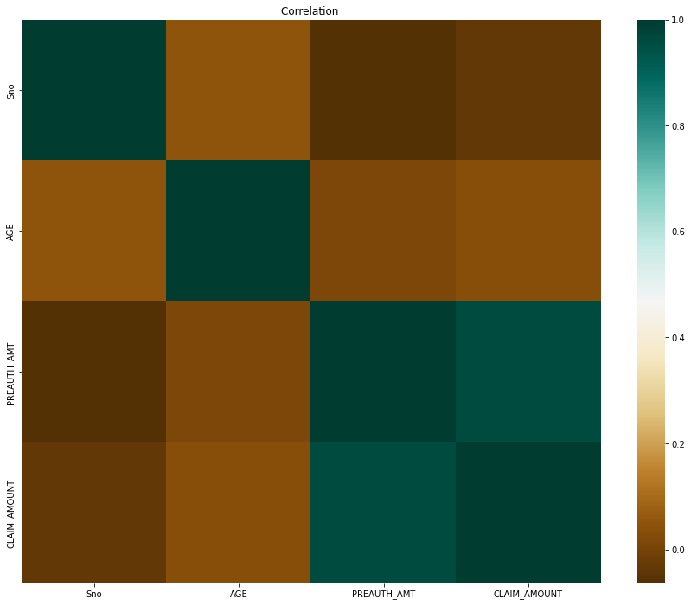
Co-relation between Age, Preauthorization amount and Claim amount

Slide 19
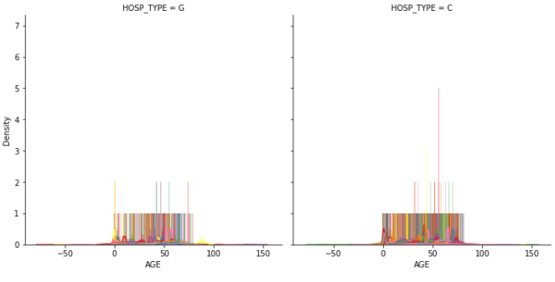
Diistrubution of premauth of amount around different age in different hospitals

Slide 20
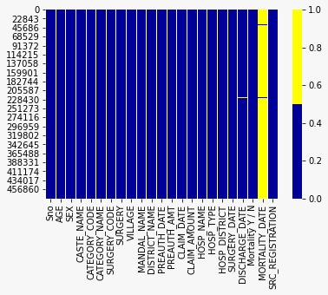
Heat map for missing values

Slide 21
DATA STATISTICS
Statistics is basically a science that involves data collection, data interpretation and finally, data validation.
The Data stats consists the terms mean , median , mode , standard deviation , count , variance and other related terms…

Slide 22
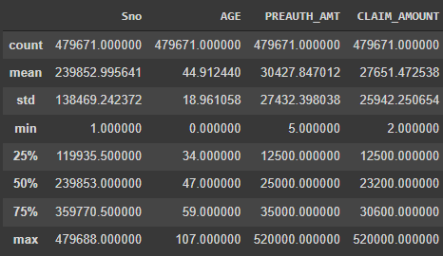
Data statistics for this dataset

Slide 23
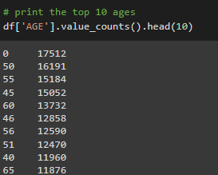

Statstics for Age :-

Slide 24
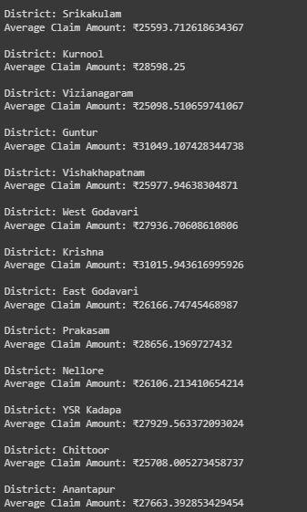
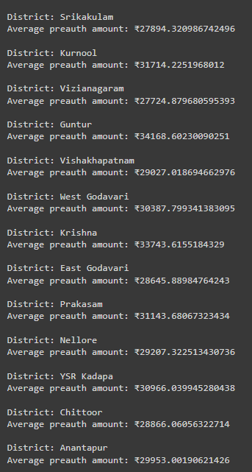
Average Claim Amount For Each District
Average Preauth Amount For Each District

Slide 25
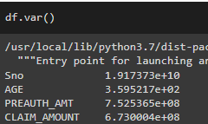
VARIANCE FOR DIFFERENT VALUES:-

Slide 26
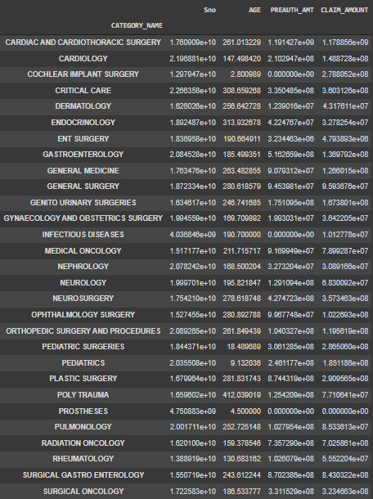
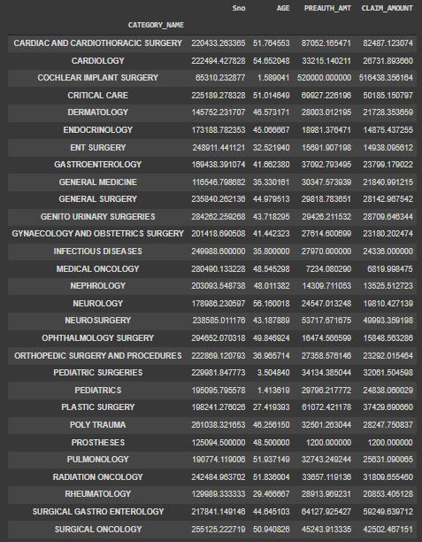
Mean for each category
Varince for each category

Slide 27
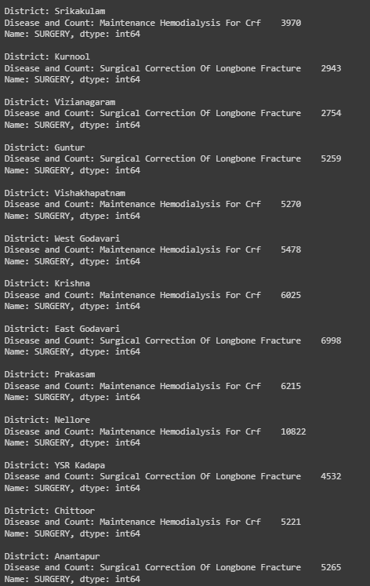
Most common disease in each District
and count of the Disease

Slide 28
Hypothesis testing
Hypothesis testing is a statistical technique that helps scientists and researchers test the validity of their claims about the real-world/real-life events.
Hypothesis testing techniques are often used in statistics and data science to analyze whether the claims about the occurrence of the events is true.

Slide 29
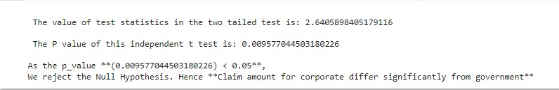
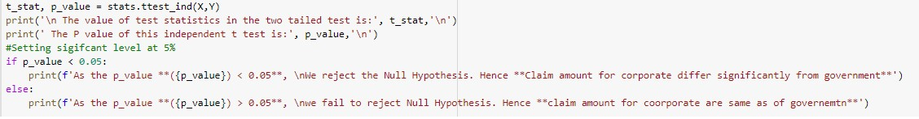
First hypothesis :-
Ho= The Claim amount in both governmnt and private hospitalls is same
H1 = The Claim amount differs in Govt and private hospital with significance level of 5%

Slide 30
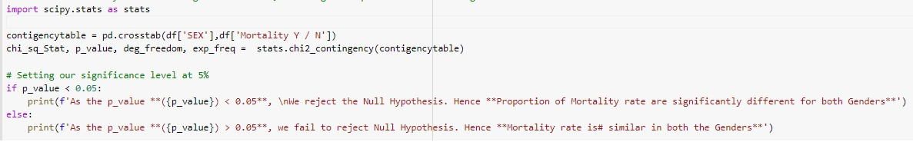
Second hypothesis ;-

